Slide 1

IO - FIT
Project architecture
Ori Arad Itamar Cohen

Slide 2
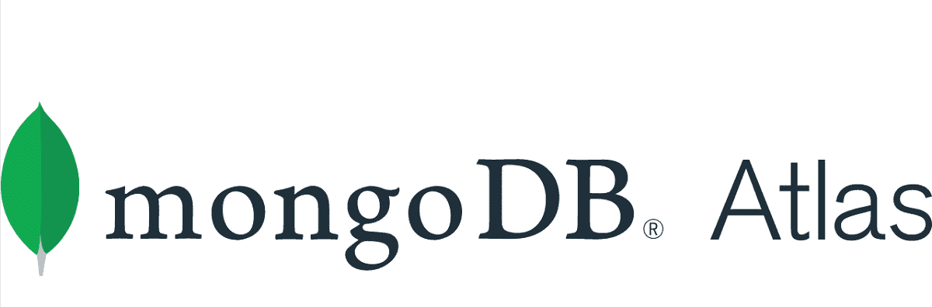

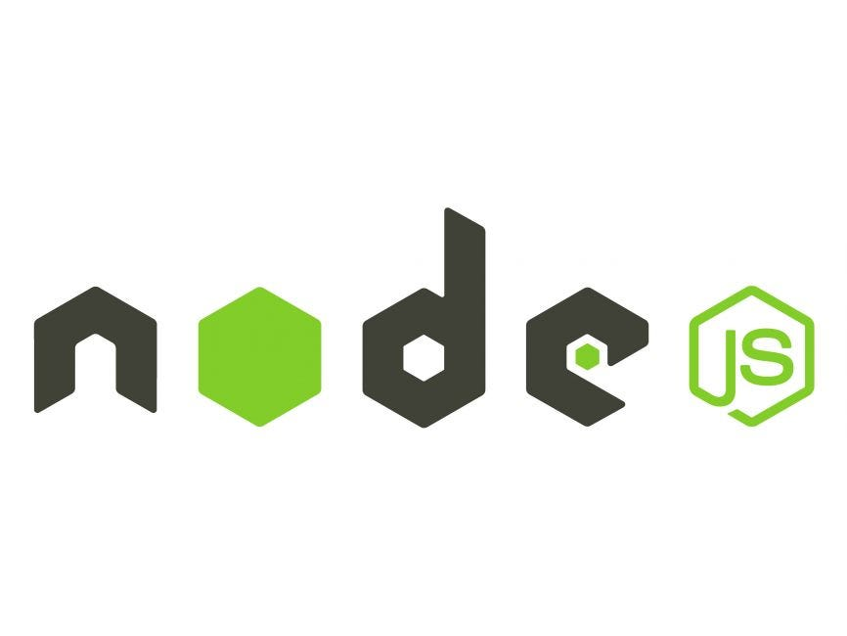
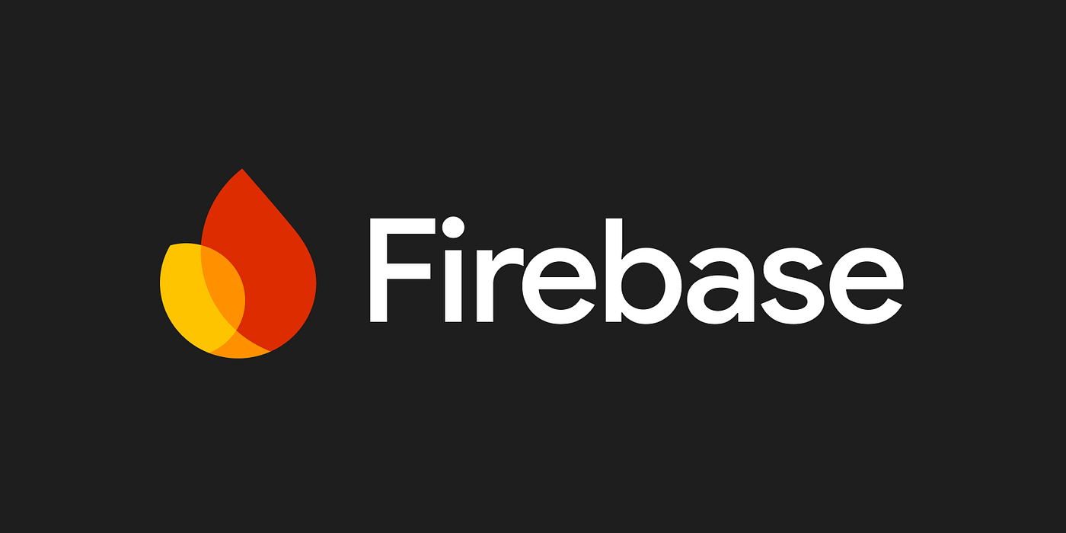
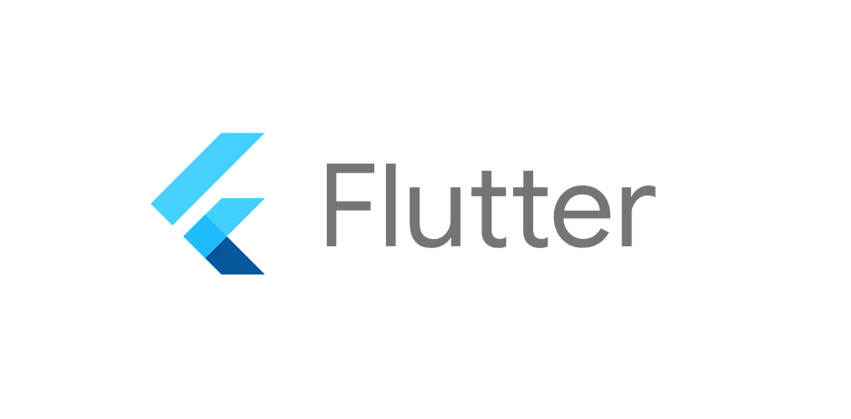

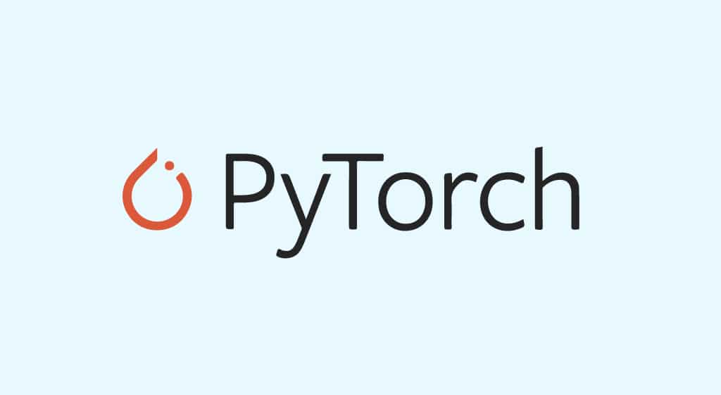
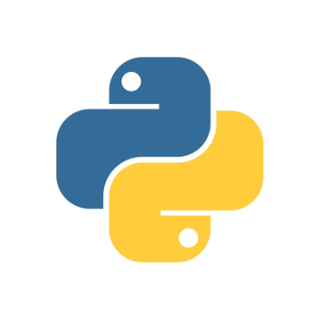
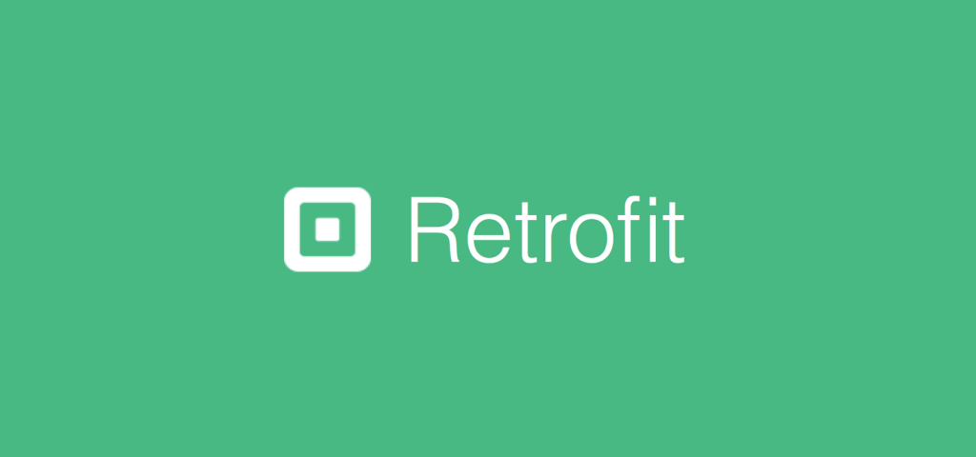
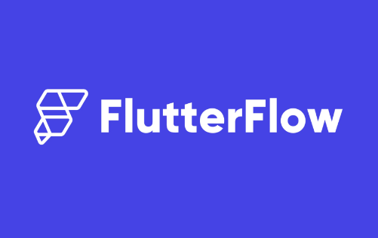
Diagram
User data
database
App server
Accounts database
Client
ML
server

Slide 3
Tools explanation
Firebase: A platform by Google that provides backend services such as authentication, real-time databases, and cloud functions. It is used here for managing the accounts database and user authentication.
MongoDB Atlas: A cloud-hosted database service for MongoDB. It stores user-specific data efficiently and integrates with the app server.
Node.js: A JavaScript runtime environment that allows running server-side code. It is used in combination with Express.js to handle the app server's backend logic.
Express.js: A minimal and flexible web application framework for Node.js. It is used to build APIs and manage the communication between the client, the accounts database, and the user data database. Flask: A lightweight Python web framework. It is used here to serve the ML server and expose machine learning functionalities.
PyTorch: A machine learning framework in Python, popular for building and training models. It powers the ML functionalities in the server.
Flutter: A UI toolkit by Google for building cross-platform applications from a single codebase. It is used for creating the client application.
Retrofit: A type-safe HTTP client for Android and Java. It is used in the client to make network requests and communicate with the app server.
FlutterFlow: A visual development platform for creating Flutter apps without deep coding knowledge. It is used to simplify the client development process.

Slide 4
References
ChatGPT: https://chatgpt.com/
ML dataset: https://github.com/siddharthkhincha/Gym-Equipment-Classifier/tree/master
Exercises dataset: https://www.bodybuilding.com/exercises (Sadly the website has been shutdown: click here for additional information and here)
FlutterFlow: https://www.flutterflow.io/

